Slide 1




Fireball!
Game Art Bible

Slide 2
Overview
“Team up with or against your friends in the Baby Dragons’ Playgrounds as you Fireball critters for the highest score in this action-packed party game!”
Fireball! is a multiplayer party game where players control cute baby dragons trying to kill cute little critters. We are using a cutesy, simplistic, and colourful visual style in order to best relay the cute and playful concept, while also taking advantage of it for a humourous contrast with the violent gameplay.
To make the experience more dynamic and hectic, we will have various powerups and a constant stream of critters. At the end of rounds, we will further add to the humour with gag achievements.

Slide 3
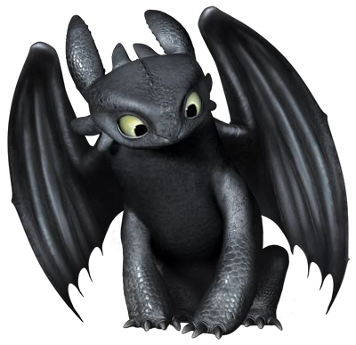
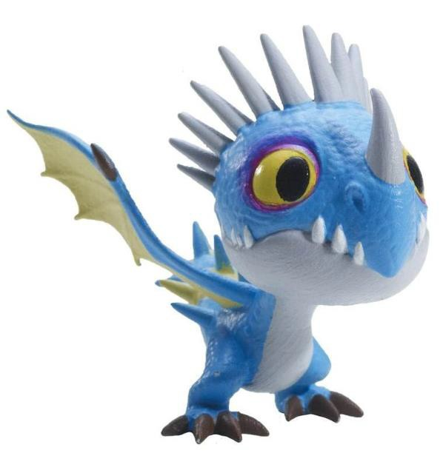
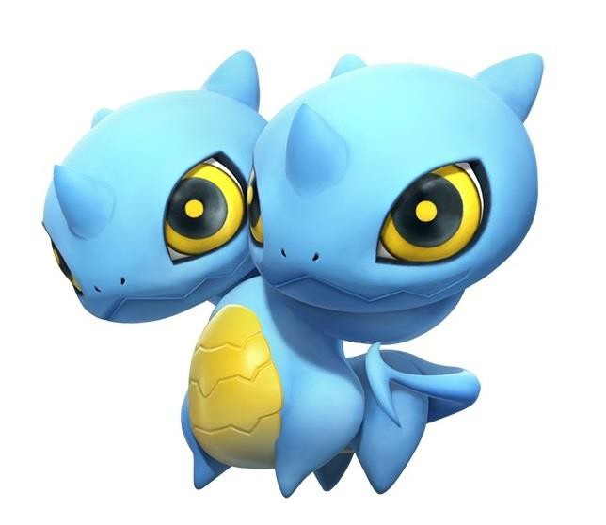
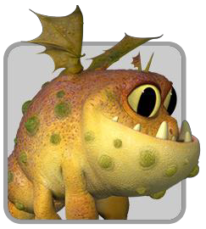
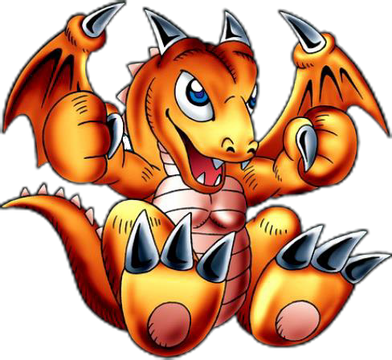
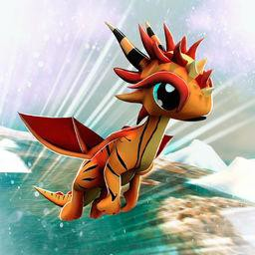
Character Style Guide
The idea behind the dragon designs is to have them be recognisably young as well as cute and cartoonish.

Slide 4
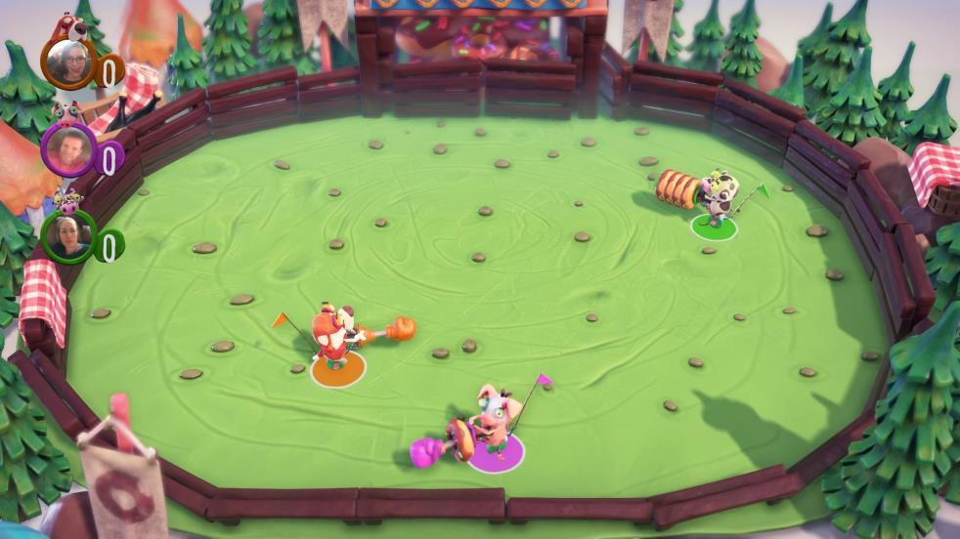
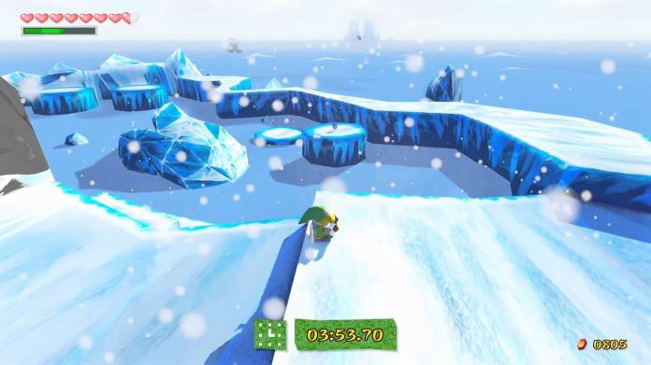
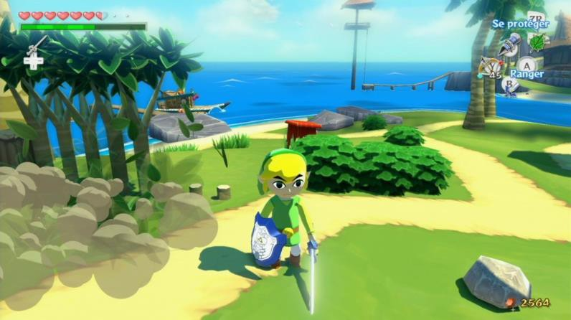
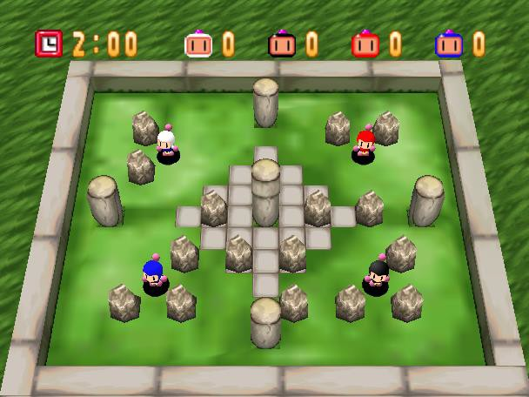
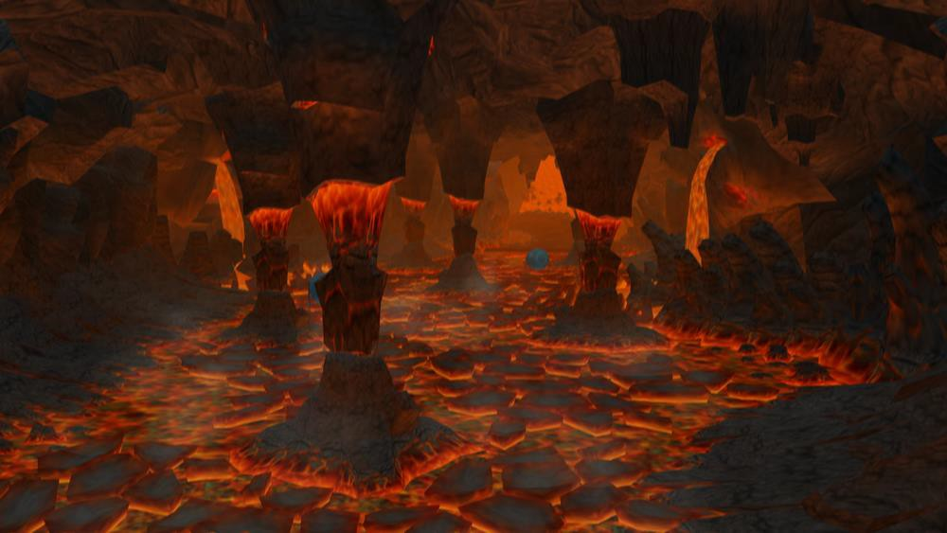
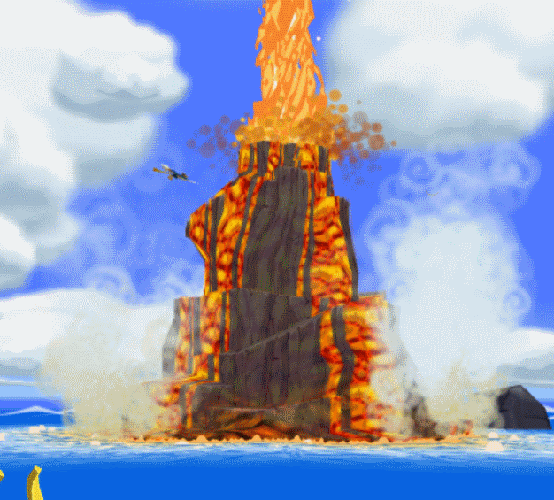
Environment Style Guide
The environments are cartoony and simplistic. Environment assets lean toward being more angular than perfectly smooth.

Slide 5
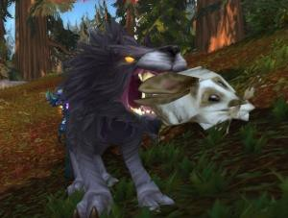
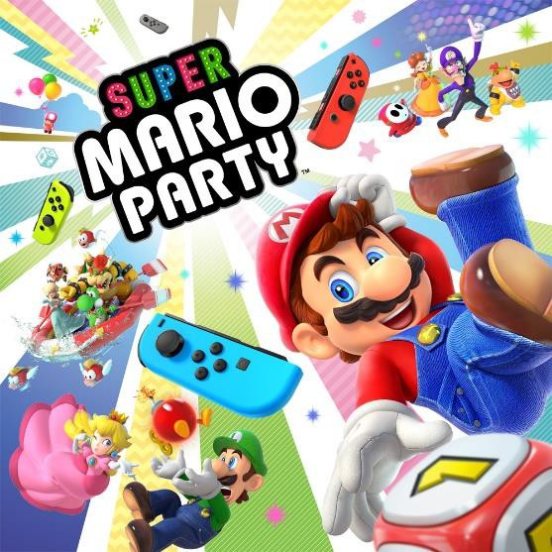
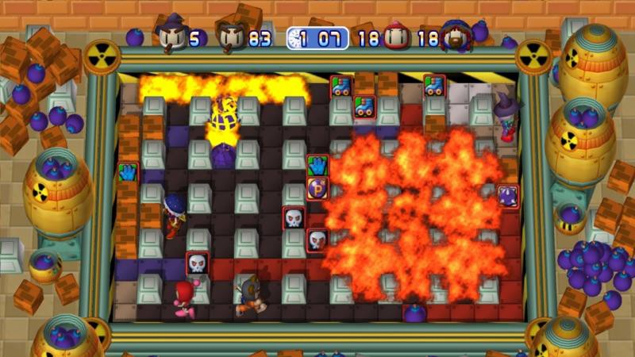
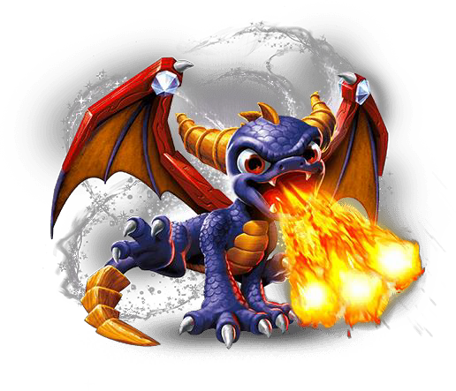
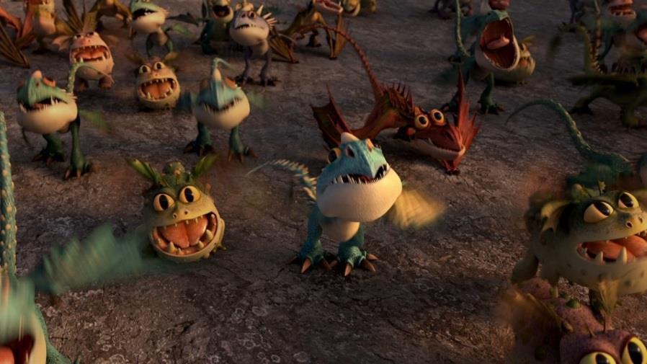
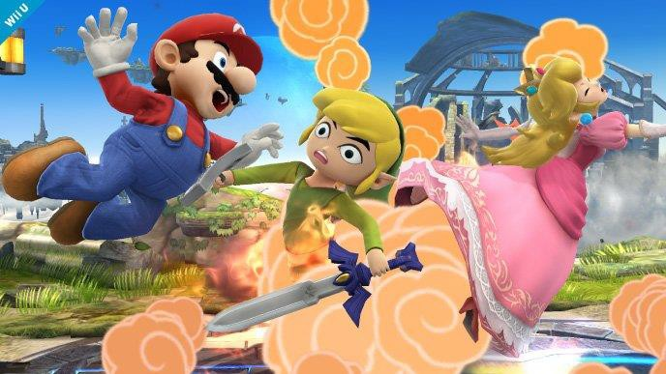
Game Moodboard
The game is colourful and ostensibly family-friendly, but also slightly morbid. It’s a hectic and violent experience while maintaining a cute exterior.

Slide 6


UI Designs
Stage Select
Fireball!
Start Instructions Options
Exit
_{F}I_{i}nst_{r}ructi_{e}ons _{ball!}
-------------
-------------
-------^{S}-^{t}--ª-^{r}--^{t}
Instructions
_{Fi}O_{r}ption_{e}s
ball!
Option Option
_{St}O_{a}pt_{r}ion_{t}
Option
InstrOupctiotnions Options
Exit
2/3
Options Exit

Slide 7

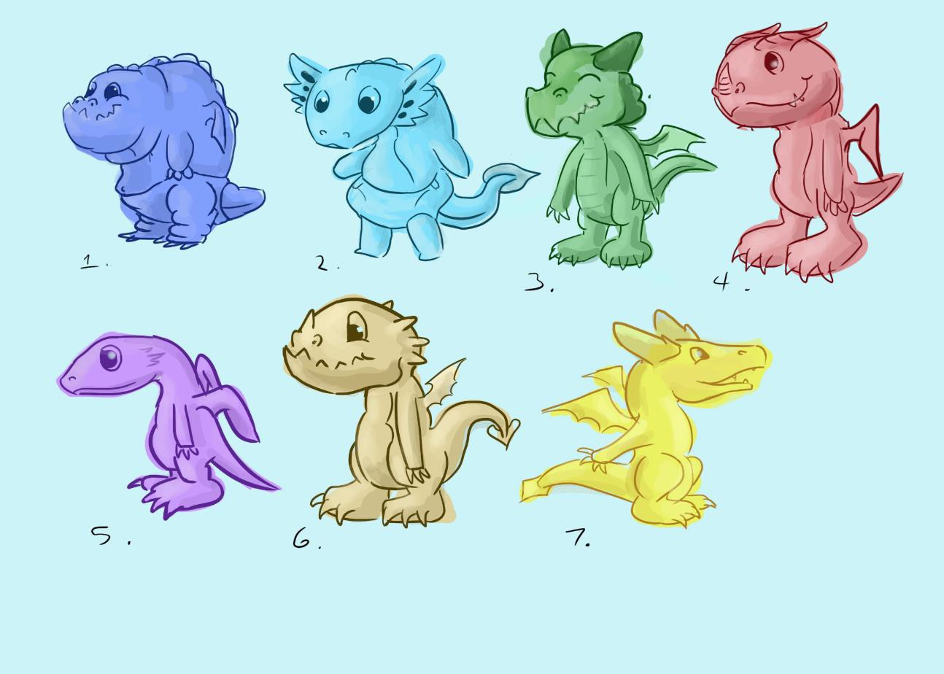

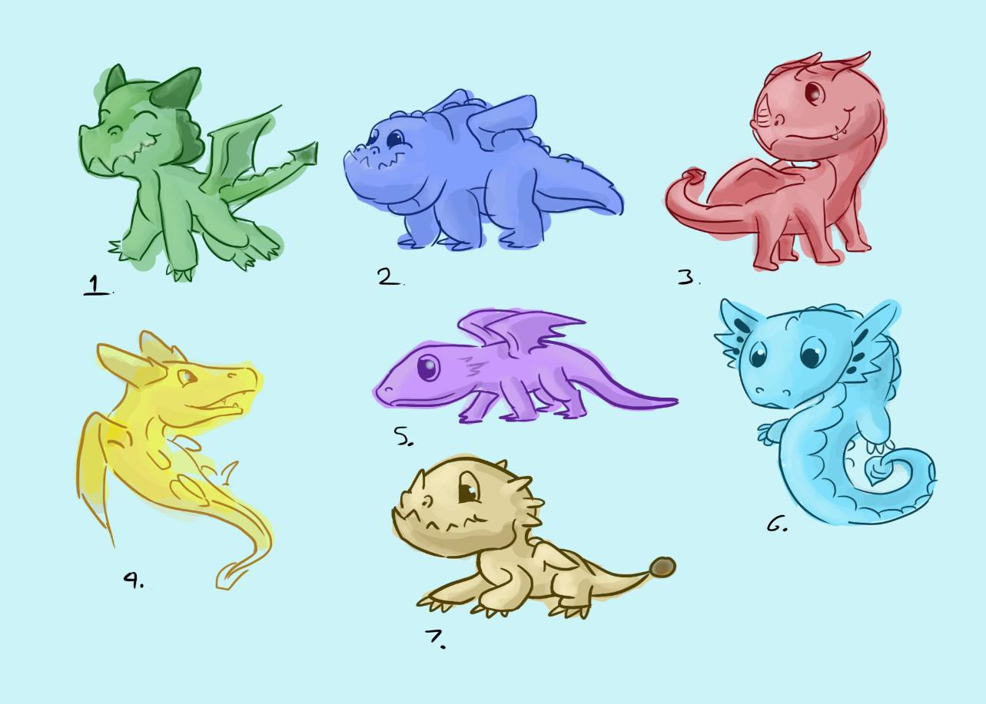
Character Thumbnails

Slide 8

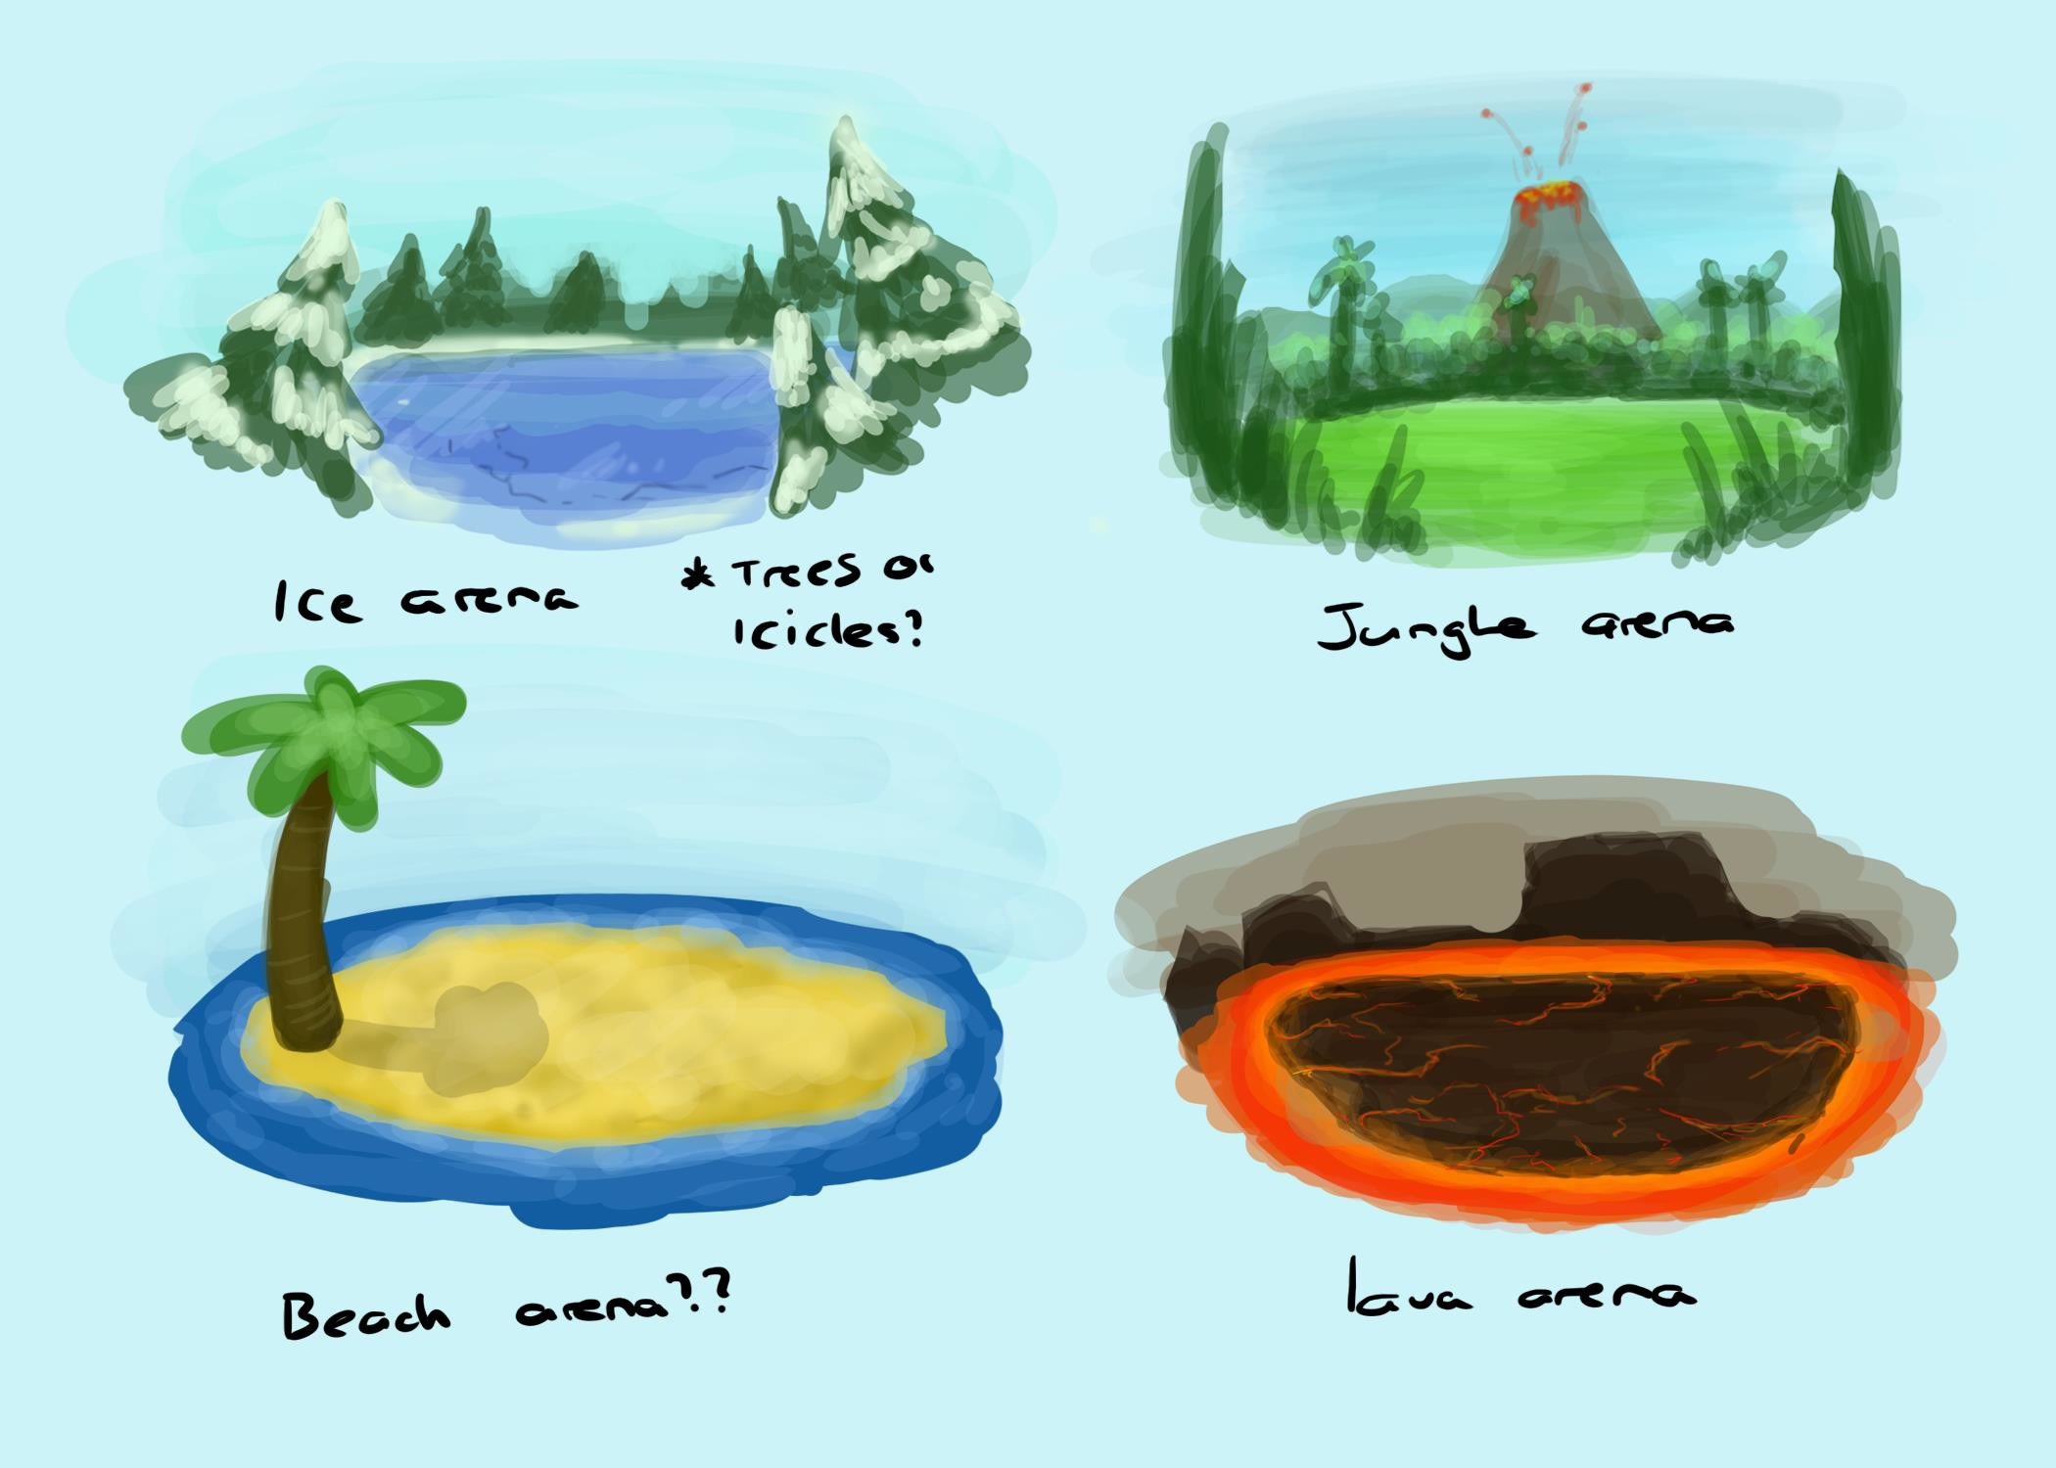
Environment Thumbnails

Slide 9
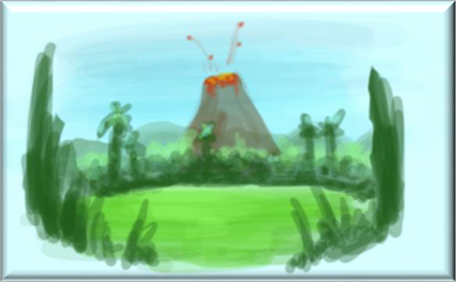

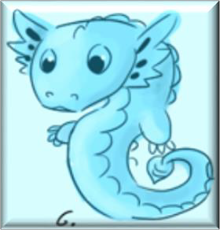
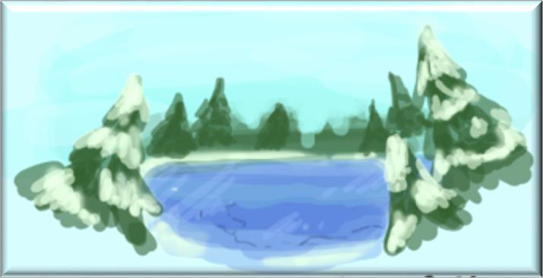

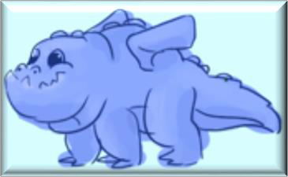

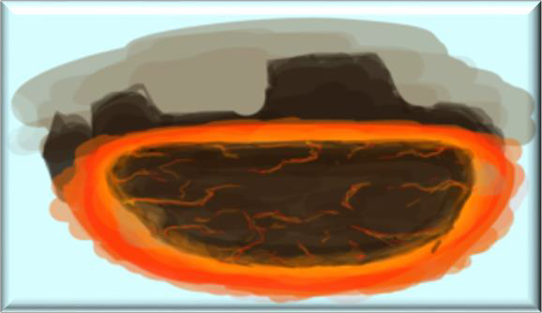
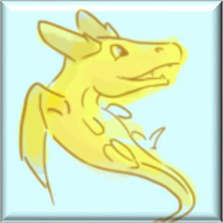

Colour Palette

Slide 10
Art Specifications
2D Assets:
File Name | Art Type: | Texture Resolution:
FB_[assetName]_UI | UI | 256 x 256
FB_[assetName]_Texture | Texture | 256 x 256
FB_[assetName]_AnimTexture | Animated Texture | 256 x 256
3D Assets:
File Name | Art Type: | Poly Count Limit:
FB_[assetName]_Prop | Prop | 200 - 400
FB_[assetName]_Char | Character | 500 - 1k
FB_[assetName]_Env | Environment | 50 - 500

Slide 11



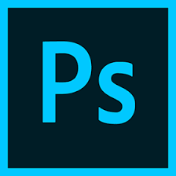

Software
Maya
ZBrush
Substance Painter
Photoshop

